Slide 1

Social network EMBEDDINGS
Ilia Karpov (iakarpov@hse.ru)
Moscow, 2020

Slide 2



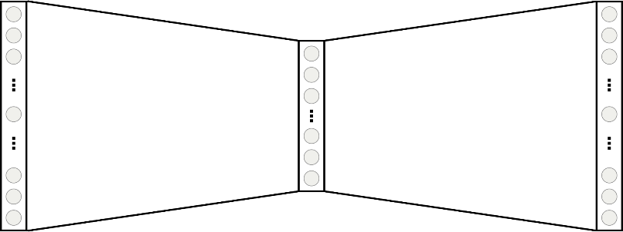



Anatomy of a neural embedding
Nodes in random walks ≈ words in sentences → use word2vec
Random walks^{[2,3,4]}
Self-supervised neural network^{[1]}
𝐖
_{𝐖}!
representation
Efficient Estimation of Word Representations in Vector Space. Mikolov et al., NIPS 2013
DeepWalk: Online Learning of Social Representations. Perozzi et al., KDD 2014
node2vec: Scalable Feature Learning for Networks. Grover & Leskovec, KDD 2016
VERSE: Versatile Graph Embeddings from Similarity Measures. Tsitsulin et al., WWW 2018
14

Slide 3
DeepWalk: algorithm overview
“Nodes in random walks ≈ words in sentences → use word2vec”
Start 𝛾 random walks of length 𝑡 from each node
Predictions with hierarchical softmax
𝐖
𝐖′!
two representations
use pairs within window size 𝑤
DeepWalk: Online Learning of Social Representations. Perozzi et al., KDD 2014

Slide 4
DeepWalk: asymptotics and practice
In practice, 𝛾 = 80, 𝑡 = 80, 𝑤 = 10, meaning 80 ∗ 80 ∗ 𝑛 of “text”
NB: never change 𝑤
If you lower 𝑤, increase 𝛾 and 𝑡
Parameter meaning is not trivial :(
DeepWalk: Online Learning of Social Representations. Perozzi et al., KDD 2014

Slide 5
DeepWalk: asymptotics and practice
Python implementation generates all walks and calls word2vec
C++ implementation that does not store extra walks Optimization is still O(d ∗ log 𝑛) at each step :(
Practical limitations: ~3M nodes
DeepWalk: Online Learning of Social Representations. Perozzi et al., KDD 2014

Slide 6
LINE: algorithm overview
“Why use random walks when edges do the trick”
Predictions with negative sampling
𝐖
𝐖′!
two representations
LINE: Large-scale information network embedding. Tang et al., WWW 2015

Slide 7
LINE: algorithm overview
“Why use random walks when edges do the trick”
Random edges
Predictions with negative sampling
𝐖
𝐖′!
two representations
LINE: Large-scale information network embedding. Tang et al., WWW 2015

Slide 8
LINE: asymptotics and practice
Simple & fast algorithm, not great on downstream tasks :(
NB: Set the total # of samples T proportional to # of edges Optimization is 𝑂 𝑑𝑛
Authors’ C++ implementation works well
Practical limitations: ~10M nodes
LINE: Large-scale information network embedding. Tang et al., WWW 2015

Slide 9
Node2vec: algorithm overview
“Let’s add two more parameters (p, q) to DeepWalk”
Start 𝛾 random walks of length 𝑡 from each node
Predictions with negative sampling
𝐖
𝐖′!
two representations
use pairs within window size 𝑤
Node2vec: scalable feature learning for networks. Grover & Leskovec, KDD 2016

Slide 10







Node2vec: algorithm overview
“Let’s add two more parameters (p, q) to DeepWalk”
Use second-order random walk sampling
𝑢 𝑣
Predictions with negative sampling
𝑢
1/_{𝑝}
1/_{𝑞}
𝐖
𝐖′!
1
𝑣 _{1/}
𝑞
two representations
¹/_{𝑝} , 1, ^{1/}_{𝑞} , ¹/_{𝑞}
Node2vec: scalable feature learning for networks. Grover & Leskovec, KDD 2016

Slide 11
Node2vec: myth 1
Myth: parameters (p, q) are related to BFS and DFS
Reality: parameters (p, q) are related to triangles ≈ clusters Low q → explore intra-cluster information
High q → explore inter-cluster information
Node2vec: scalable feature learning for networks. Grover & Leskovec, KDD 2016

Slide 12

Node2vec: myth 2
Myth: node2vec is a scalable algorithm
Reality: second-order random walks are worst-case 𝑂 𝑛!
Worst case is a star graph
(or any graph with very high-degree nodes)
Node2vec: scalable feature learning for networks. Grover & Leskovec, KDD 2016

Slide 13
Node2vec: asymptotics and practice
NB: comparisons in the paper are misleading (𝛾 = 10 for all methods)
In the paper, 𝛾 = 10, 𝑡 = 80, 𝑤 = 10, hyperparameter search for (p, q)
Setting 𝛾 = 10 gives worse results, please use 𝛾 = 80
Tuning (p, q) is not beneficial on most graphs
Node2vec: scalable feature learning for networks. Grover & Leskovec, KDD 2016

Slide 14
Node2vec: asymptotics and practice
Python implementation generates all walks and calls word2vec
C++ implementation that does not store extra walks Preprocessing can be 𝑂 𝑛! :(
Optimization is 𝑂 𝑑 :)
Practical limitations: ~500k nodes if you are lucky, if not, ~50k
Node2vec: scalable feature learning for networks. Grover & Leskovec, KDD 2016

